Slide 1
Other Web Data and Standards
SE495: Software and Systems Integration

Slide 2
Outline
Google Protocol Buffers and Big Table
Feed: RSS and Atom
JSON
HTTP Operations
Intro to Ontology languages: Complex XML

Slide 3
Google Protocol Buffers and Big Table

Slide 4
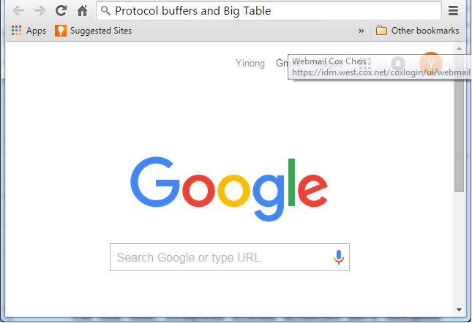
Google Data Description and Management
Googol
Protocol buffers and Big Table

Slide 5
How can Google be so fast?
Distributed and Parallel Computing: Buildings of machines
Crawling and Indexing Working 24/7
Caching Buffering the frequently and recently used links and pages
Specifically designed service-oriented computing model: Removing SOAP, using HTTP directly: RESTful service, instead of WSDL/SOAP services
Specifically designed data structures and data management

Slide 6
Google Data Description Language? XML and XML Schema?
What is the data description language used by Google?
XML is universal and standard for representing data on Web;
XML may be slow for Google’s amount of Data;
Think about the amount of information stored in Google directories – Any efficiency improvement will be significant;
A good design needs compromise / tradeoff between flexibility and efficiency

Slide 7
Google Protocol Buffers
http://code.google.com/apis/protocolbuffers/docs/overview.html
Compared to XML and XML Schema, Protocol buffers:
are simpler
are 3 to 10 times smaller in presenting the same information
are 20 to 100 times faster in processing
are less ambiguous
generate data structures that are similar to object-oriented classes and thus are easier to use programmatically
are less flexible/adaptable

Slide 8
Google Protocol Buffers Example
message Person {
required string name = 1;
required int32 id = 2;
optional string email = 3;
enum PhoneType {
WORK = 0;
HOME = 1;
MOBILE = 2;
}
message PhoneNumber {
required string number = 1;
optional PhoneType type = 2 [default = WORK];
}
repeated PhoneNumber phone = 4;
}

Slide 9
A Similar Description in XML Schema
<element name = Person>
<complexType>
<sequence>
<element name = "Id" type="integer" minOccurs="1" maxOccurs="1"/>
<element name = "Name" type="string" minOccurs="1" maxOccurs="1"/>
<element name = "Email" type="string" minOccurs="0" maxOccurs="1"/>
<element name = "Phone" type="string" minOccurs="1" maxOccurs="1"/>
</sequence>
</complexType>
</element>
<element name = "Phone" >
<simpleType>
<restriction base = "string" >
<enumeration value = "Work" type=minOccurs="1" maxOccurs="1"/>
<enumeration value = "Home" minOccurs="0" maxOccurs="1"/>
<enumeration value = "Mobile" minOccurs="0" maxOccurs="1"/>
</restriction>
</element >

Slide 10
Using Protocol Buffer for Service Development: gRPC
Lecture 10
https://cloud.google.com/endpoints/docs/grpc/about-grpc
https://www.grpc.io/docs/
gRPC is a high performance, open-source universal RPC framework, developed by Google.
In gRPC, a client application can directly call methods on a server application on a different machine as if it was a local object, making it easier to create distributed applications and services.
gRPC exposes endpoints to the outside to enable different types of clients.
gRPC client
HTTP / JSON clients
We show an example of using Visual Studio to develop a gRPC service and client

Slide 11
Google BigTable
http://en.wikipedia.org/wiki/BigTable
BigTable is a fast and extremely large-scale database management system;
It is a compressed, high performance, and proprietary database system built on Google File System (GFS);
It departs from the convention of relational database, with a fixed number of columns;
The database is “a sparse, distributed multi-dimensional sorted map”.
What is it?
The idea is similar to B Tree and B+ Tree that allow for efficient insertion, retrieval and removal of nodes.

Slide 12
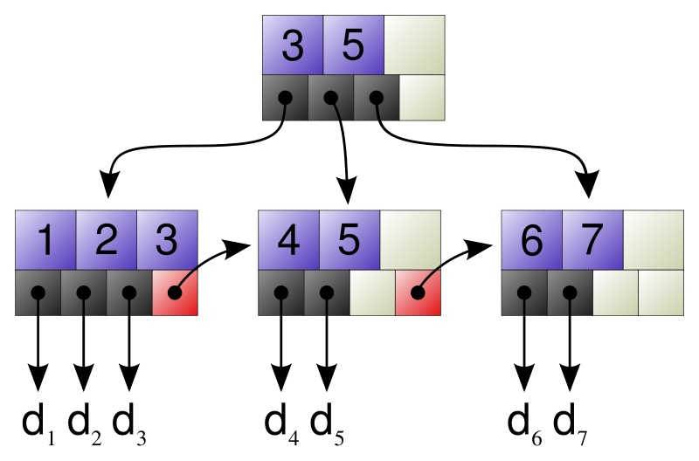
B Tree and B+ Tree
http://en.wikipedia.org/wiki/B%2B_tree
It extends the binary search tree.
It is a tree representing sorted data in a way that allows for efficient insertion, retrieval and removal of records, each of which is identified by a key: key-value database.
It is a dynamic, multilevel index, with maximum and minimum bounds on the number of keys in each index node.
In a B+ tree, in contrast to a B Tree, all records (values) are stored at the lowest level of the tree (leafs). Only keys are stored in interior blocks

Slide 13
B+ Tree-Based BigTable (Key-Value Store)
Keys are sorted in certain traversing order
Root Index keys
•
12
•
31
•
38
•
47
•
Level Two Index
•
2
•
5
•
9
•
•
•
20
•
21
•
26
•
30
•
•
32
•
36
•
•
•
•
GFS
(Store Values)
d₁
d₂
d₃
d₄
d₅
d₆
d₇
d₈
d₉
d_{n}

Slide 14
Distributed Software Development through Data Standards
Example: A University Enterprise System
Enrollment applications
Applications evaluation
Student ranks / admission
Data standards and transformation
HTML
Text
XML
JSON
Excel
Grade book in Canvas
Grades in university student DB
Grade transfer to other schools

Slide 15
How Do You Do Conversion?
HTML
Text
XML
JSON
Excel
20 data converters
HTML
Text
XML
JSON
Excel
Why not use HTML as the main language?
HTML
JSON
XML
8 data converters
XML is a meta language, while HTML is a concrete language
Text
Excel

Slide 16
XML and Development
GML (1969)
SGML is too complex to process
SGML (1985)
SOAP
WSDL
RDF
RDFS
OWL
Atom
RSS
…
HTML (1991)
XML (1998)
XHTML
XAML

Slide 17
Other Web Data Representations
Web formats | Description
XML | The premier format for defining data, protocol, and languages
HTML | The traditional format for representing Web data and format
XHTML | Extended HTML 4.01 to conform with the XML format
RSS | RSS (Really Simple Syndication) for feed readers and Web blogs
Atom | Atom extends RSS, and it is also used for representing feeds for feed readers and blog publishing. It has been used in wider context, including the REST architecture.
POX | Plain-Old-XML is used for representing SOAP data, which does not need the header information for complex processing.
JSON | JavaScript Object Notation is efficient for representing data processed or to be processed by a program, such as JavaScript.
Protocol buffers | Google’s Web data structure for search engine.
BigTable | Google’s data structure for large database management.

Slide 18
XML Related Technologies (Review)
HTML
XHTML
XAML
Document
Type Definition
DTD
Schema
XML Parser
XML Query
Language
XPath
XQL
SOAP
WSDL
UDDI/ebXML
RDF, OWL
BPEL
XML-based
Protocols and Languages
XML
XSL
XSLT
XML Style and
Transformation
Atom
POX
RSS
DOM
SAX
Data Feed
XML Parsers

Slide 19
Feed: RSS, Atom, and JSON

Slide 20
Why Other Data Formats?
XML is flexible and can be used to define any data structure in a rooted tree.
For any specific data structure, an XML schema or DTD is needed to define the structure.
For convenience, a few predefined XML data structures are used, which do not need a schema file:
POX
RSS
ATOM
They are widely used in Web page feed: Another Web page can conveniently read your Web data with structure, instead of a string.

Slide 21
RSS: An XML-based Feed Data Structure
A feed is a data structure that contains a list of items
Each items is described by a few attributes, including the hyperlink and other information of the item, such as title, author, etc.
RSS is a language used to describe syndicated feed data.
A number of RSS versions exist.
RSS 1.0 stands for RDF Site Summary, where RDF (Resource Description Framework) is an ontology language widely used in semantic Web authoring.
RSS 2.0 stands for Really Simple Syndication. It is an XML document with a specific schema definition.

Slide 22
RSS Schema, with a four-layer structure
Four-level structure

Slide 23
An Example of RSS Document
<?xml version="1.0"?>
<rss version="2.0">
<channel>
<title>Computer Science Books</title>
<link>http://cslibrary.asu.edu/</link>
<description>
This example will be further discussed in RESTful service in Chapter 7.
</description>
<item>
<title>Operating Systems</title>
<link>http://mylibrary.asu.edu/authors/{author=Aaron}</link>
<description>Operating system design and analysis</description>
<author>aaronauthor@asu.edu</author>
</item>
…
<channel>
<title>Biology Science Books</title>
…
Channel
title
…
description
link
copyright
webmaster
pubDate
image
. . .
item
. . .
item
Channel

Slide 24
An Example of RSS Document (contd.)
title
<item>
<title>Compilers</title>
<link> http://cslibrary.asu.edu/years/{year=1999}</link>
</item>
<item>
<title>Algorithm Analysis and Design</title>
<author>zetaauthor@asu.edu</author>
</item>
</channel>
<channel>
<title>Biology Science Books</title>
<link>http://biolibrary.asu.edu/</link>
. . .
Channel
description
link
copyright
webmaster
pubDate
image
. . .
item
. . .
item

Slide 25
An Example of RSS Document (contd.)
<channel>
<title>My Books</title>
<link>http://mylibrary.asu.edu/</link>
<item>
<title>Programming Languages</title>
<link>http://www.kendallhunt.com/index.cfm</link>
<description>
Introduce different programming paradigms and program techniques
</description>
<author>yinong.chen@asu.edu</author>
</item>
</channel>
</rss>

Slide 26
Atom
RSS 2.0 widely used for representing feed data for its simplicity.
It is a really simple syndication, which does not have many features that today’s feed data desired to have.
There are frequent reports with the interoperability problems with different feed readers and protocols.
Atom is a more recent language designed for describing feed data with more features and with improved structure.

Slide 27
Atom Schema, with a three-layer structure
Three-level structure, but with more elements

Slide 28



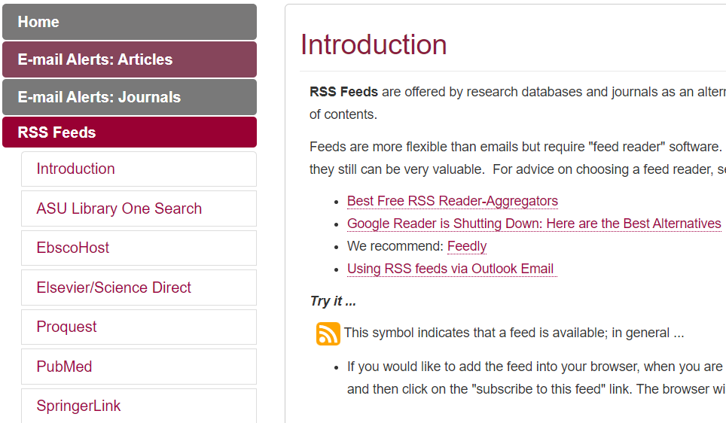
Feeds Applications: ASU Feed

Slide 29
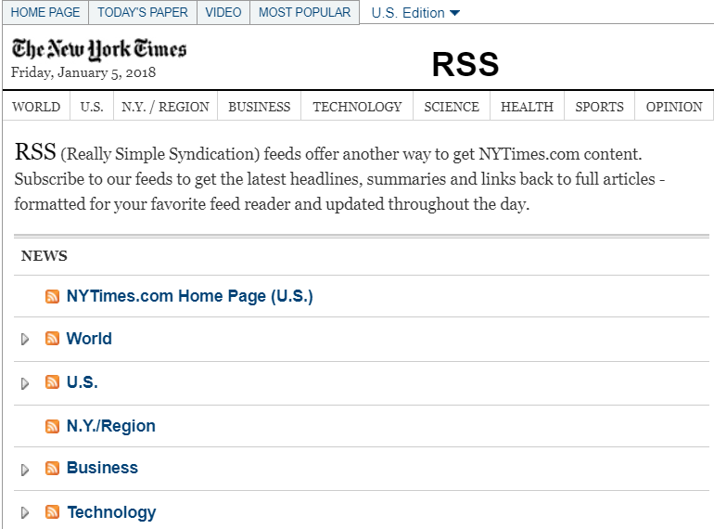
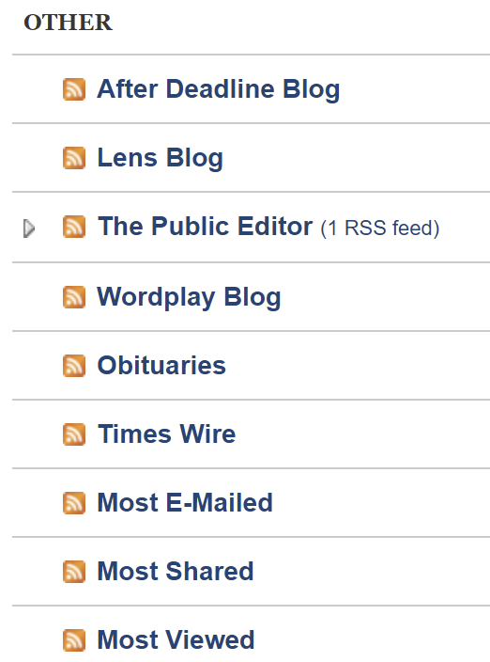
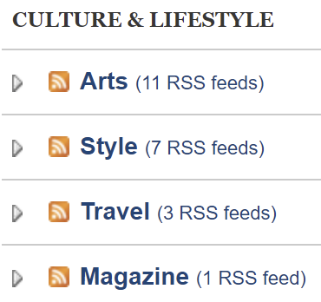
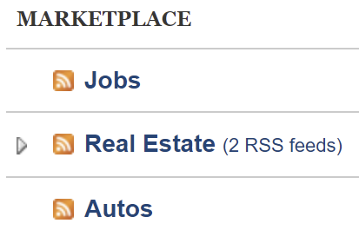
Feeds Applications: New York Times
RSS feeds offer another way to get NYTimes.com content.
You can get the latest headlines, summaries and links back to full articles - formatted for your favorite feed reader and updated throughout the day.

Slide 30
What is a Mashup? https://en.wikipedia.org/wiki/Mashup_(web_application_hybrid)
Mashup: is a service-oriented composition method. It composes one or multiple Web applications using multiple resources, including Web applications, services, APIs, and feeds data from different vendors. Many mashup applications can be created.
Application
Application
Application
…
Application
Mashup Pipes
Google
Yahoo
Amazon
eBay
Craiglist
…
Yapis

Slide 31
Mashup Ideas
Sources
Mashup pipes
Mashup output
Map
Weather achieve
Sunshine
Wind
Rainfall
Robotics service
Solar generator
Windmill
Farmer services
Fashion services
Barbie services
Map with solar power plants
Map with windmill power plants
Map with Farmers
Fashion designs

Slide 32
Widgets: A simpler Version of Mashups
A simpler version of mashup without programming;
Data sources are connected to a web page without processing/blending
Sources :
IBM Widget Composer:
Amazon Widget Source:
http://www.simile-widgets.org/
https://www.ibm.com/support/knowledgecenter/en/SSZLC2_8.0.0/com.ibm.commerce.pagecomposerframework.doc/tasks/tpzwidgetcreatesrccd.htm
https://widgets.amazon.co.uk/Widget-Source/
http://pollen.com/
http://airnow.gov/
Web page
Web page
Data source or WS 1
Data source
Widget 1
Mashup
Web service
Widget 2
Data source or WS 2
Data source or WS n
Mashup output
Widget n

Slide 33
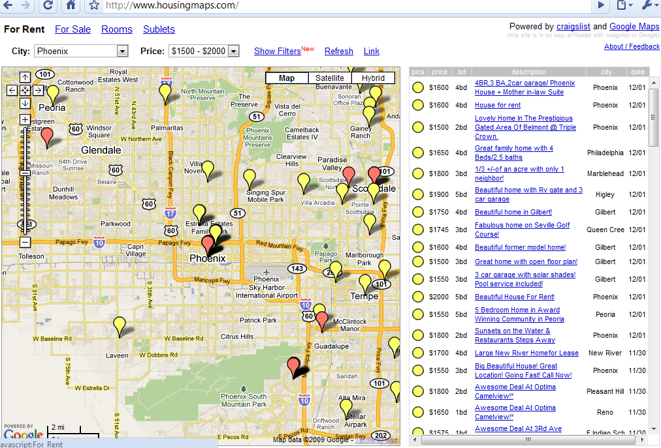
Mashup Applications: HousingMaps
http://HousingMaps.com was the first Google Maps mashup, created before there was a Google Maps API.
It feeds Craigslist apartment/housing listings on a map
The idea that real estate was best browsed on a map. Real estate sites was showed lists of properties only!
Other mashup: Music mashup:
https://mashup.mixedinkey.com/

Slide 34
JSON (JavaScript Object Notation)
JSON is a light-weight alternative to XML for simple data-interchange
JSON is simpler than XML and more compact
JSON uses no tags, and it uses braces instead, like programming language
XML parsing is harder because of its complexity
JSON has fixed schema (structure definition), and it is not as extensible as XML
Preferred for simple data exchange by many
Transforms to other formats? Find library or write your own.

Slide 35
JSON (JavaScript Object Notation)
<number>
<string>
<object>
value
<array>
true
false
null

Slide 36
JSON Number and Object Format
number
0
.
<digit>
-
+
<digit1-9>
e
E
<digit>
<digit>
-
object
{
<string>
:
<value>
}
,
A list of string-value pairs
Object Example
{"name":"John Doe", "age":25, "married":true, "University":"ASU", "Graduated":false, "Courses":{"CSE240":200,"CSE310":300,"CSE445":400, "GPA":3.75}}

Slide 37
JSON Array
Different types of values are allowed in one array.
array
[
<value>
]
,
Array of string
["John Doe", "Marry", "Smith"]
Array of
mixed values
[{"John Doe":25}, {"Marry":30}, "Smith", 20, true]
Array of arrays
[
[1, 2, 3, 4],
[2, 3, 4, 5],
[5, 2, 3, 5]
]
for(var i=0;i<myArray.length;i++)
{
console.log(myArray[i].name, myArray[i].value);
}

Slide 38
XML vs. JSON
object
{ “studentInfo” :
{ “students” :
[
{
“name” : “John Doe”,
“phone” : 4801234567
},
{
“name” : “Mary Smith”,
“phone” : 6022345678 },
{
“name” : “April Lee”,
“phone” : 6233456789 },
]
}
}
<studentInfo>
<students>
<student>
<name>John Doe</name>
<phone>4801234567</phone>
<student>
<student>
<name>Mary Smith</name>
<phone>6022345678</phone>
<student>
<student>
<name>April Lee</name>
<phone>6233456789</phone>
<student>
</students>
</studentInfo>
object
array
object

Slide 39
Processing RSS, Atom, and JSON Data Example
https://msdn.microsoft.com/en-us/library/cc197957(v=vs.95).aspx
JsonArray users = (JsonArray)JsonArray.Load(responseStream);
var members = from member in users
where member["IsMember"]
select member;
foreach (JsonObject member in members)
{
string name = member["Name"];
int age = member["Age"];
// Do something...
}
Query in LINQ
To be discussed in CSE446/598

Slide 40
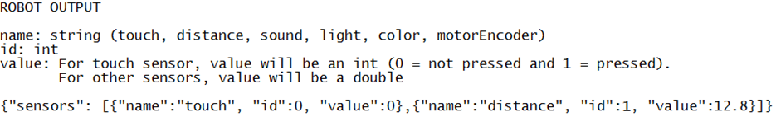
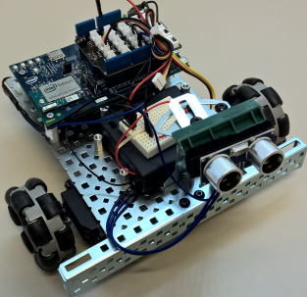
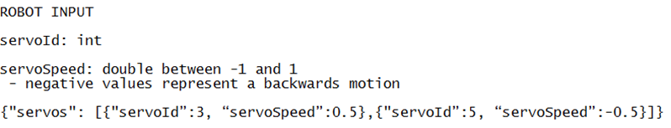
JSON Object Defined for IoT Communication Discussed in more detail in Text Chapter 9
ASU VIPLE
Visual IoT Programming
An object pair, with the second element an array of objects
IoT / Robot
Object
Array
Object
Object

Slide 41
Where are RSS, Atom, and JSON used?
They are widely used in
Web data integration – Web page feed: Another Web page can conveniently read your Web data with a structure, instead of in a string.
What did you do in Project 3 for getting data from any web page?
They are widely used as the RESTful service outputs.
Top 5 Web Mashups: https://science.howstuffworks.com/innovation/repurposed-inventions/5-web-mashups.htm
The Tracktor
Poligraft
ThisWeKnow
SonDNA
TrendsMap

Slide 42
Multiple Choice Check
Why do we need RSS, Atom, JSON, instead of using general XML? Choose one!
General XML is too simple to represent feed data.
General XML cannot represent a collection of data.
General XML is a meta language, and it can be used to define languages only.
General XML file requires a schema definition, while RSS, Atom, and JSON have fixed schemas and do not need to attach a schema file. A simpler and fixed structure is good enough for most feed applications.

Slide 43
HTTP (Hypertext Transfer Protocol) Operations and SOAP over HTTP

Slide 44
HTTP (Version 1.1)
http://www.w3.org/Protocols/rfc2616/rfc2616.html
HTTP is an application-level protocol for distributed, collaborative, and hypermedia information systems.
HTTP messages are always two ways: requests from client to server and responses from server to client.
HTTP-message = Request | Response
Request: Request-Line =
Method SP Request-URI SP HTTP-Version CRLF
Response: Status-Line =
HTTP-Version SP Status-Code SP Reason-Phrase CRLF
where, SP: Space and CRLF: end of line mark
Syntax

Slide 45
HTTP Methods
The Method indicates the operation to be performed on the resource identified by the Request-URI. The method is case-sensitive.
GET
retrieves the information (entity) identified by Request-URI.
If the Request-URI refers to a data-producing process (method), the produced data shall be returned in the response.
HEAD
The HEAD method is identical to GET, except that the server MUST NOT return a message-body in the response.
Used to obtain meta-information about the entity implied by the request without transferring the entity-body itself.
Use for making one-way call.

Slide 46
HTTP Methods (contd.)
PUT: For creating and modifying/replacing resource. It requests the enclosed entity to be stored under the supplied Request-URI.
If the Request-URI refers to an already existing resource, the enclosed entity SHOULD be considered as a modified version of the one residing on the origin server.
If the Request-URI does not point to an existing resource, and that URI is capable of being defined as a new resource by the requesting user agent, the origin server can create the resource with that URI.
If a new resource is created, the origin server MUST inform the user agent via the 201 (Created) response.

Slide 47
HTTP Methods (contd.)
POST: used to request the server to accept the (data) entity enclosed in the request as a new subordinate of the resource identified by the Request-URI in the Request-Line. Used for
Annotation of existing resources;
Posting a message to a bulletin board, newsgroup, mailing list, or similar group of articles;
Providing a block of data, such as the result of submitting a form, to a data-handling process;
Extending a database through an append operation.
POST and PUT have some similarity, but are used in different situations:
POST: append;
PUT: replace or create

Slide 48
HTTP Methods (contd.)
DELETE: requests that the origin server deletes the resource identified by the Request-URI.
The client cannot be guaranteed that the operation has been carried out, even if the status code returned from the origin server indicates that the action is successful. Why?
However, the server SHOULD NOT indicate success unless, at the time the response is given, it intends to delete the resource or move it to an inaccessible location.
TRACE: invoke a remote, application-layer loop-back of the request message.
CONNECT: for use with a proxy that can dynamically switch to a tunnel (e.g., SSL tunneling)
Not to hold the client for too long

Slide 49
HTTP Method Response Codes
Sample Response Codes:
200 (OK)
201 (Created)
202 (Accepted)
204 (No Content)
301 (Moved Permanently)
400 (Bad Request: Server does not understand the command)
401 (Unauthorized user)
403 (Forbidden)
404 (Not Found: The service/app not deployed or not registered to Web Administrative Service)
500 (Internal Server Error)
501 (Not Implemented)
.svc is not accessible by default. Need to override the security setting

Slide 50
HTTP Methods vs. RESTful Services
An HTTP method is necessary for a traditional HTTP request, where no programming method / function is defined on server side.
A RESTful service is also accessed by an HTTP request, but it is defined by a function / method, on server side. It does not necessarily need an HTTP method, and thus, HTTP GET can be used when we define a RESTful service, even if the service is about storing data into the server.
We may use other HTTP methods, for specific services, for example, use HTTP Head method for defining a one-way service call.

Slide 51
SOAP Over HTTP
As a higher-level protocol, SOAP messages are carried by a lower-level protocol. Often, it is bound to HTTP;
An HTTP client identifies the server via a URI, connects to it using underlying protocols, e.g., TCP/IP;
SOAP is a one-way message exchange protocol; It relies on HTTP to relate the return message to the requesting message;
HTTP implicitly correlates its request message with its response message, through its POST, GET and INVOKE methods, which support SOAP’s web method call and return value:
Use the HTTP POST method for conveying SOAP message in the body of a HTTP request and response message;
Use the GET method in an HTTP request to return a SOAP message in the body of an HTTP response.

Slide 52
SOAP: Simple Object Access Protocol
SOAP protocol is used to transport messages between Web services and Web applications;
SOAP is a one-way message protocol
A SOAP packet is an XML document
Like any communication protocol, a SOAP packet consists of wrapper information and payload;
A SOAP packet is often wrapped in an HTTP packet and sent as a part of HTTP packet over the internet;
SOAP packet is in XML format, which looks as follow:
<soap:Envelope>
<soap:header> . . . </soap:header>
<soap:body> . . . </soap:body>
</soap:Envelope>

Slide 53
SOAP Example: Travel Itinerary
<?xml version='1.0' ?>
<soap:Envelope xmlns:soap="http://www.w3.org/2003/05/soap-envelope">
<soap:Header>
<m:reservation xmlns:m="http://travelcompany.example.org/reservation"
soap:role="http://www.w3.org/2003/05/soap-envelope/role/next"
soap:mustUnderstand="true">
<m:reference>uuid:093a2da1-q345-739r-ba5d-pqff98fe8j7d</m:reference>
<m:dateAndTime>2001-11-29T13:20:00.000-05:00</m:dateAndTime>
</m:reservation>
<n:passenger xmlns:n="http://mycompany.example.com/employees"
soap:role="http://www.w3.org/2003/05/soap-envelope/role/next"
soap:mustUnderstand="true">
<n:name>David Smith</n:name>
</n:passenger>
</soap:Header>

Slide 54
SOAP Example: Travel Itinerary
<soap:Body>
<p:itinerary xmlns:p="http://travelcompany.example.org/reservation/travel">
<p:departure>
<p:departing>New York</p:departing>
<p:arriving>Phoenix</p:arriving>
<p:departureDate>2012-01-24</p:departureDate>
<p:departureTime>late afternoon</p:departureTime>
<p:seatPreference>aisle</p:seatPreference>
</p:departure>
<p:return>
<p:departing>Phoenix</p:departing>
<p:arriving>New York</p:arriving>
<p:departureDate>2012-01-30</p:departureDate>
<p:departureTime>early-morning</p:departureTime>
<p:seatPreference>window</p:seatPreference>
</p:return>
</p:itinerary>
<q:lodging xmlns:q="http://travelcompany.example.org/reservation/hotels">
<q:preference>none</q:preference>
</q:lodging>
</soap:Body>
</soap:Envelope>

Slide 55
Example of SOAP Over HTTP with a return value
HTTP Request
GET/StockQuoteService
http://www.ibm.com HTTP/1.1
Accept: application/soap+xml
Accept-Charset: utf-8
Content-Type: application/soap+xml
Content-Length: nnnn
<soap:Envelope>
<soap:Body>
<abc:GetStockQuote>
<abc:symbol>IBM</abc:symbol>
</abc:GetStockQuote>
</soap:Body>
</soap:Envelope>
HTTP Response
HTTP/1.1
200 OK
Content-Type: application/soap+xml; charset="utf-8"
Content-Length: nnnn
<soap:Envelope>
<soap:Body>
<abc:GetStockQuoteResponse>
<abc:value>85.00</abc:value>
</abc:GetStockQuoteResponse>
</soap:Body>
</soap:Envelope>

Slide 56
Example of SOAP Over HTTP, without a return value
HTTP Request
HEAD/DataService
http://www.ibm.com HTTP/1.1
Accept: *;q=0
Content-Type: application/soap+xml; charset="utf-8"
Content-Length: nnnn
<soap:Envelope>
<soap:Body>
<cds:INSERT>
<abc:SomeDataToInsert />
</cds:INSERT>
</soap:Body>
</soap:Envelope>
HTTP Response
HTTP/1.1 204 No Content
Why not to use PUT/DataService?
The detail of the operation (INSERT) is given in the SOAP message. It does not matter what HTTP method to use.
Use HEAD can create a non-blocking (loosely coupled, asynchronous) one-way communication.
In RESTful service design, it removes the SOAP layer. In that case, PUT could be used in this case of INSERT data.

Slide 57
Intro to Ontology languages: Complex XML For machine learning and semantic Web

Slide 58
XML Related Technologies (RDF and OWL)
HTML
XHTML
XAML
Document
Type Definition
DTD
Schema
XML Parser
XML Query
Language
XPath
XQL
SOAP
WSDL
UDDI/ebXML
RDF, OWL
BPEL
XML-based
Protocols and Languages
XML
XSL
XSLT
XML Style and
Transformation
Atom
POX
RSS
DOM
SAX
Data Feed
XML Parsers

Slide 59
Semantic Web (Web 3.0) and Ontology
Semantic Web is a vision for the future of the Web
Information is given explicit meaning
It is possible for Web services to automatically process and integrate information available on the Web.
Ontology is a method of implementing AI and semantic Web, which is
a conceptual model of a domain (ontological theory)
a formal specification of a problem to be solved
machine-readability with computational semantics
commonly understandable
unambiguous in terminology definition
Example: automated interview system
Ontology languages are in XML – complex XML

Slide 60
Ontology Language for Knowledge Representation
An ontology language (RDF, OWL) defines:
A knowledge base,
a vocabulary of terms (words)
their meanings (semantics),
their interconnections (e.g., synonym and subset), and
rules of inference for machine learning
XML-based ontology languages
Use elements to define vocabulary
Use attributes to mark up the meanings
Use XML structure for interconnections
Use external services to execute rules represented in XML data

Slide 61
Semantic Web Language Stack
Semantic Web / AI Human User interface
Semantic Web / AI Programmer’s interface
Reasoning/Proof
Data Access
Ontology Instance / AI / Knowledge Base
Ontology Vocabulary
Ontology Languages: RDF, RDFS, OWL
XML and XML Schema
URI
Unicode
Semantic Web and Machine Learning Development Environment

Slide 62
Summary
XML and Web Data Representations
Feed: RSS
Atom
JSON
HTTP Methods and Services Using the Methods

